Slide 1
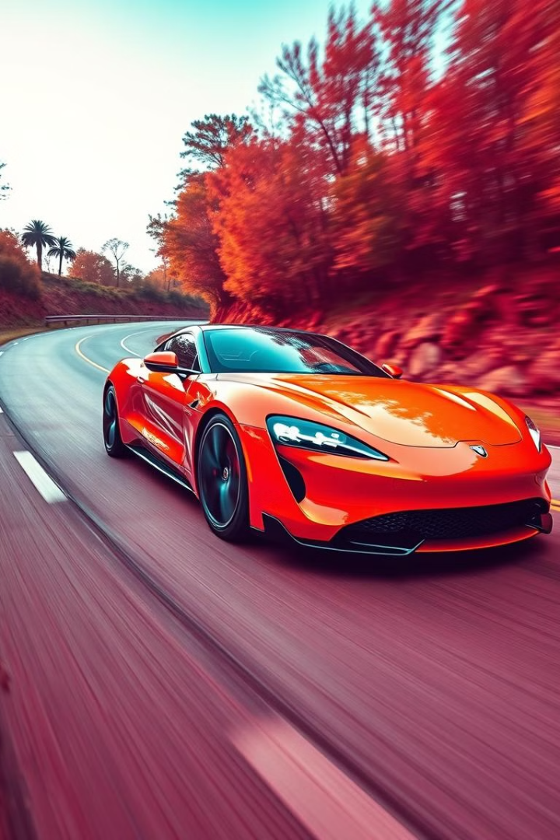
Sports Car Data Analysis
Welcome to our in-depth analysis of the sports car market. We'll dive into key metrics, popular models, performance trends, and more to uncover insights that can help enthusiasts and industry professionals alike.

Slide 2
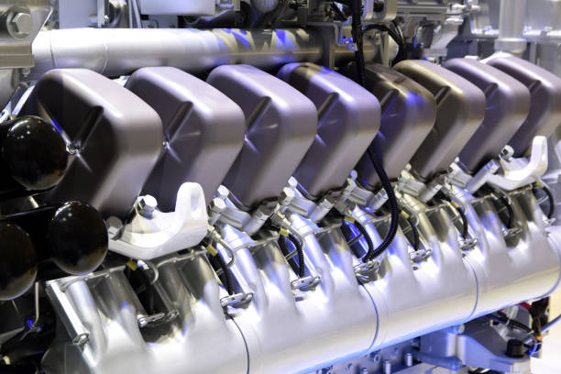
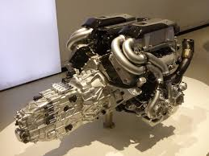
Key Metrics: Engine, Performance, Price
Engine Size
Performance
Price
We'll examine engine displacement across makes and models to understand power output and efficiency.
0-60 mph times and horsepower/torque figures provide a window into acceleration and driving dynamics.
Analyzing the price range of sports cars can reveal market segmentation and value propositions.

Slide 3
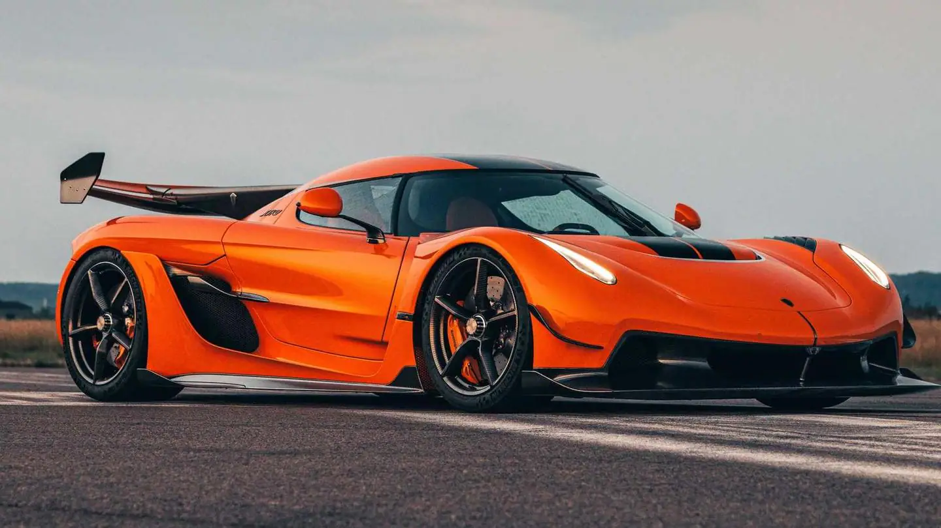
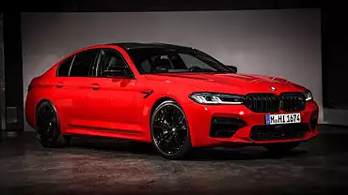
Some Beast Car Making Companies
Koenigsegg
Ferrari
Known for their iconic Zesko Absolute model and other high-performance Powerful sports cars.
Legendary Italian brand producing some of the most exclusive and powerful sports cars in the world.
Chevrolet
BMW
American muscle car stalwart, with the Corvette leading the charge in the sports car segment.
German automaker famous for their driver-focused sports coupes and convertibles.

Slide 4

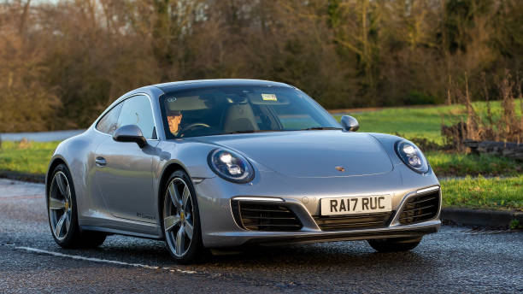
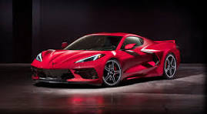
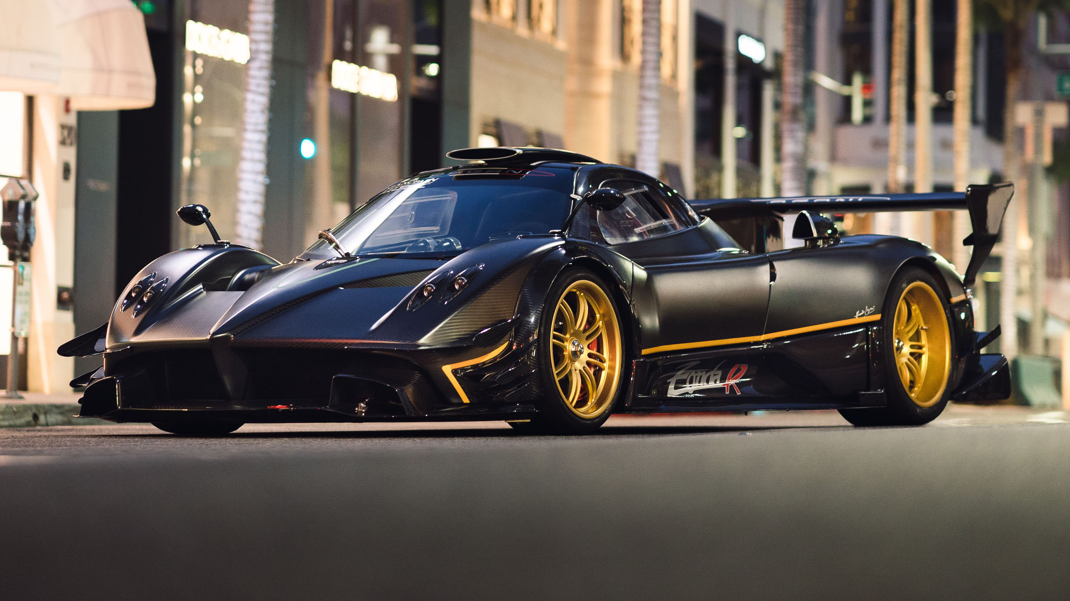
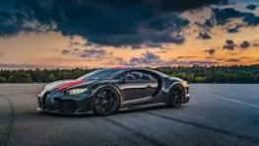
Most Popular Models
Porsche 911
Chevrolet Corvette
Pagani Zonda R
Buggati Chiron SuperSports
A sports car icon known for its distinctive rear-engine design and incredible performance.
American muscle car legend, blending eye-catching style with impressive power and handling.
Cutting-edge mid-engine sports car that combines advanced technology with driver engagement.
Lightweight, nimble roadster that delivers pure driving pleasure at an accessible price point.

Slide 5

Horsepower Analysis
1000+
750+
Extreme(Used in Hyper Cars)
High-Performance(Used in Super Cars)
500+
350+
Balanced(Used in Muscle Cars)
Entry-Level(Used in Sports Cars)
Horsepower is a crucial metric for sports cars, as it directly impacts acceleration, top speed, and overall driving dynamics. We'll examine the distribution of horsepower across the market to understand performance tiers and trends.

Slide 6
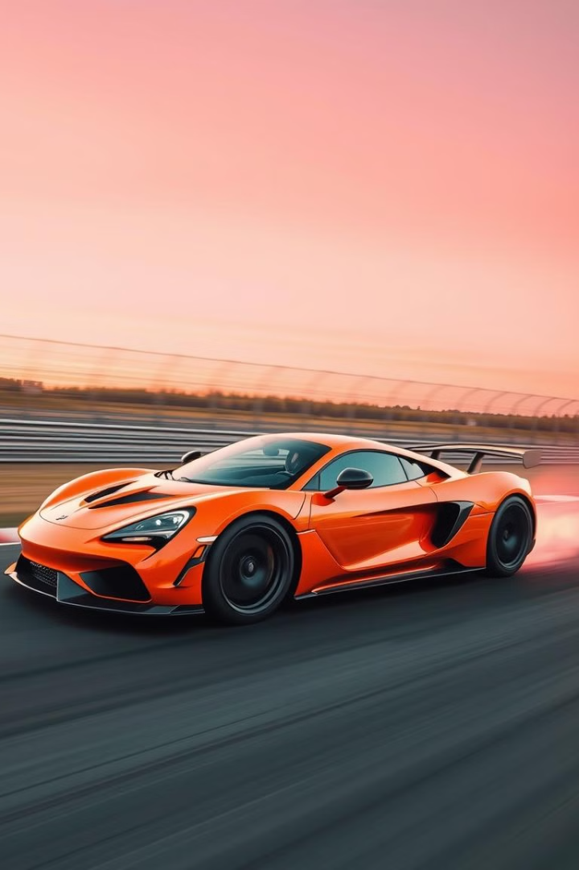
0-60 MPH Time Trends
1
2000
Average 0-60 mph time: 4.2 seconds
2
2010
Average 0-60 mph time: 3.5 seconds
3
2020
Average 0-60 mph time: 2.8 seconds

Slide 7




Relationship Between Torque and Cylinders
V12
1
High-end supercars
V10
2
Powerful sports cars
Inline 6
3
Balanced performance
Inline 4
4
Efficient sports cars
We'll explore how the number of engine cylinders correlates with torque output, revealing insights into performance segmentation and engineering approaches across the sports car market.

Slide 8
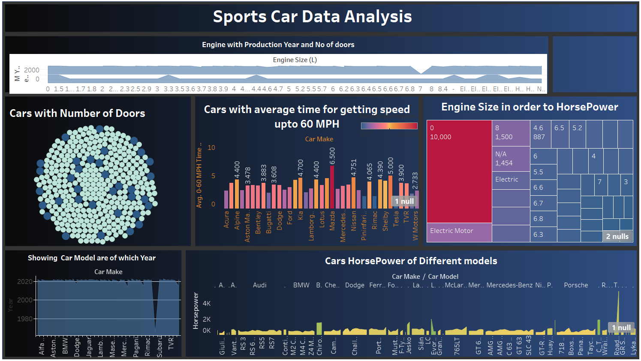

Slide 9
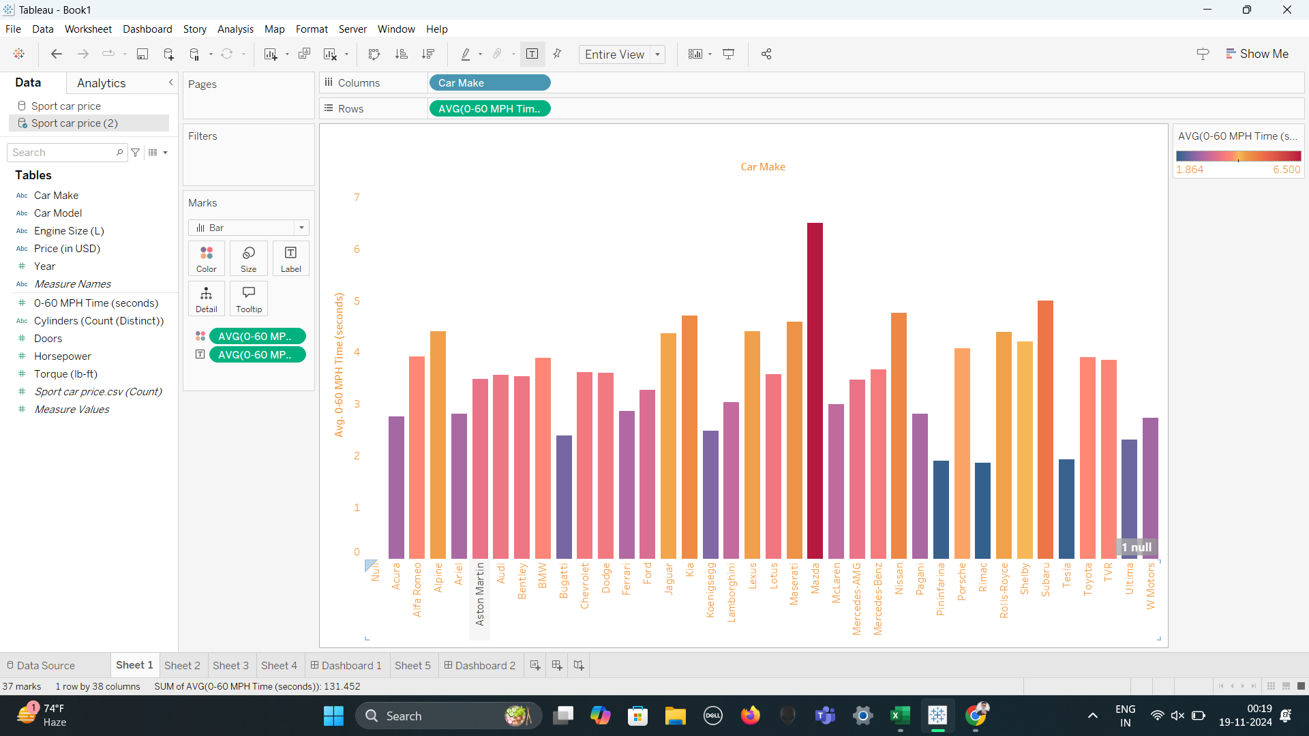
Cars with average time for getting speed upto 60 MPH

Slide 10
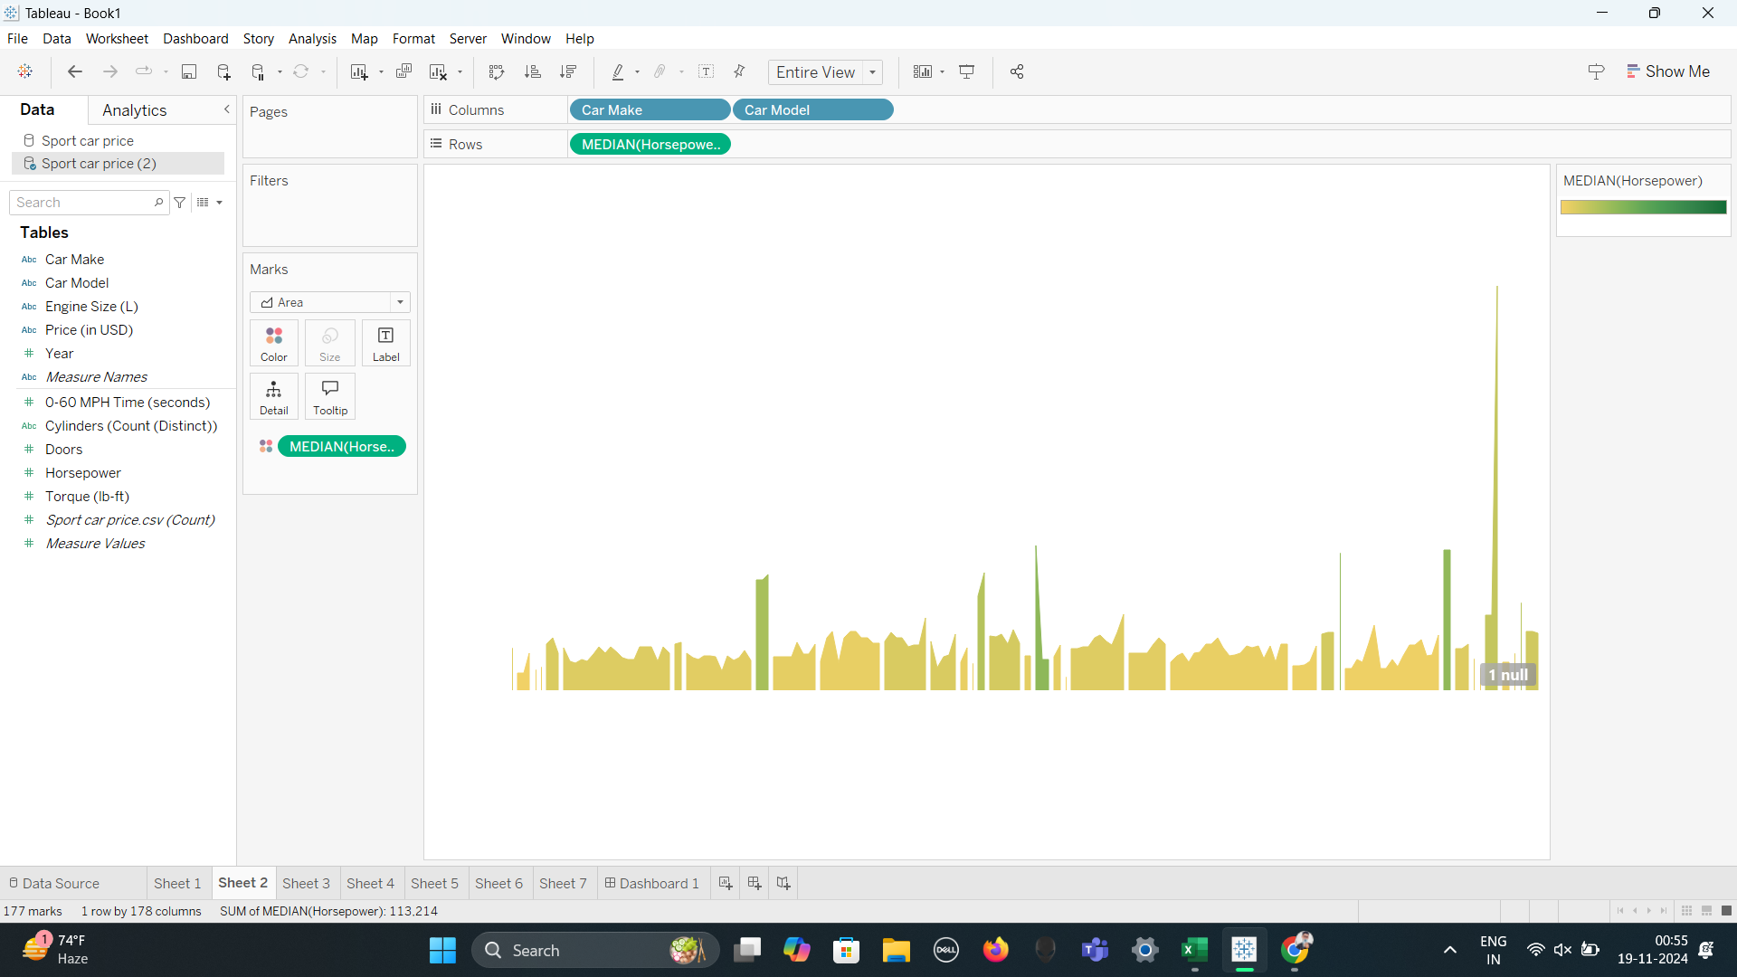
Cars HorsePower of Different models

Slide 11
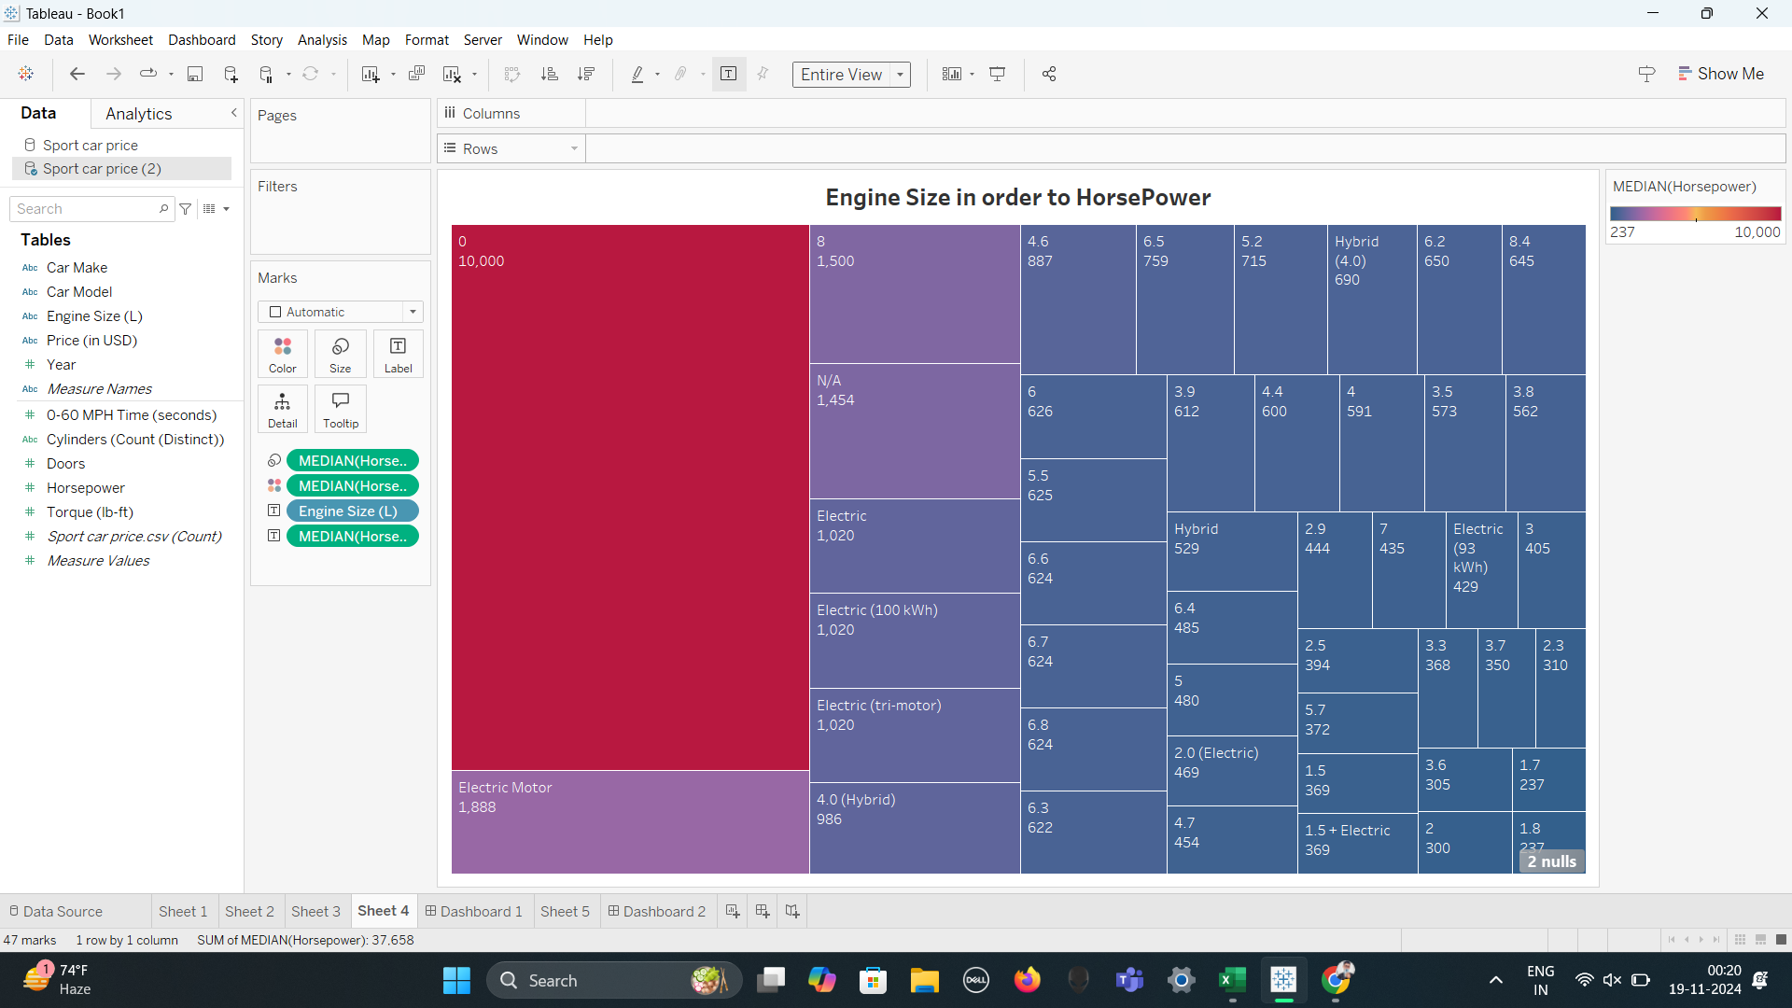
Engine Size in order to HorsePower

Slide 12
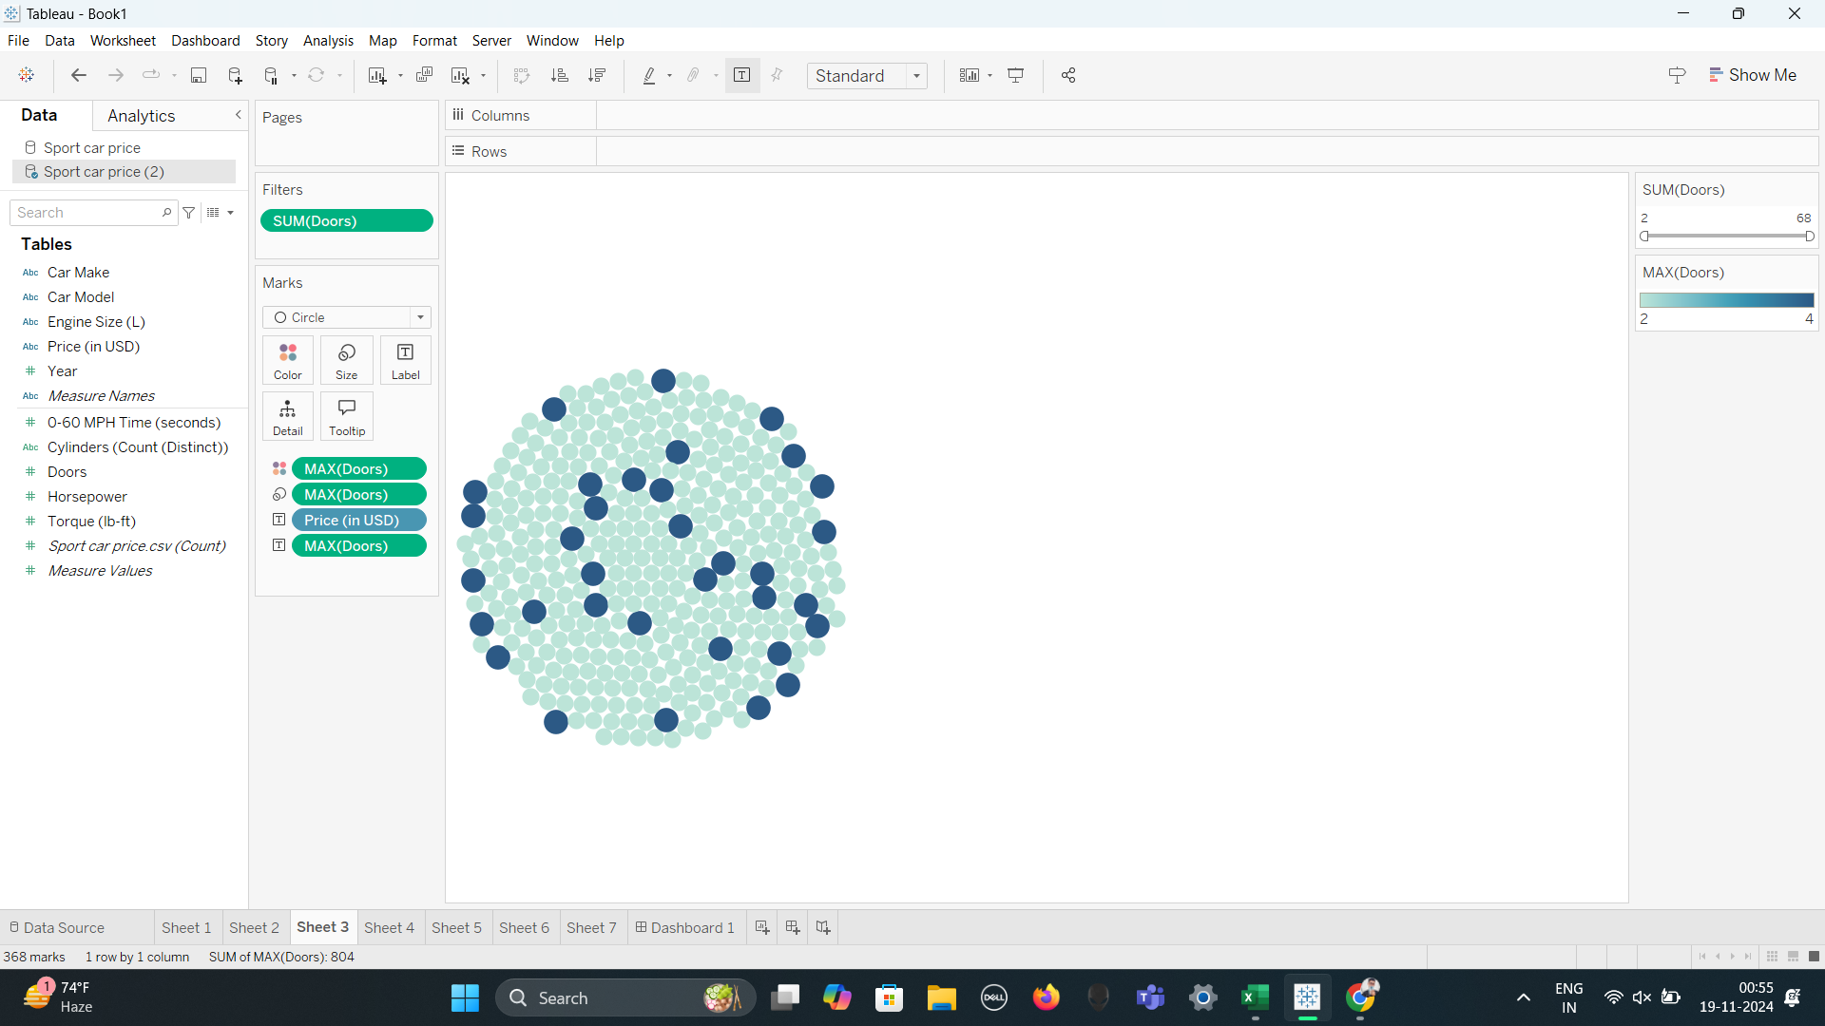
Cars with Number of Doors

Slide 13
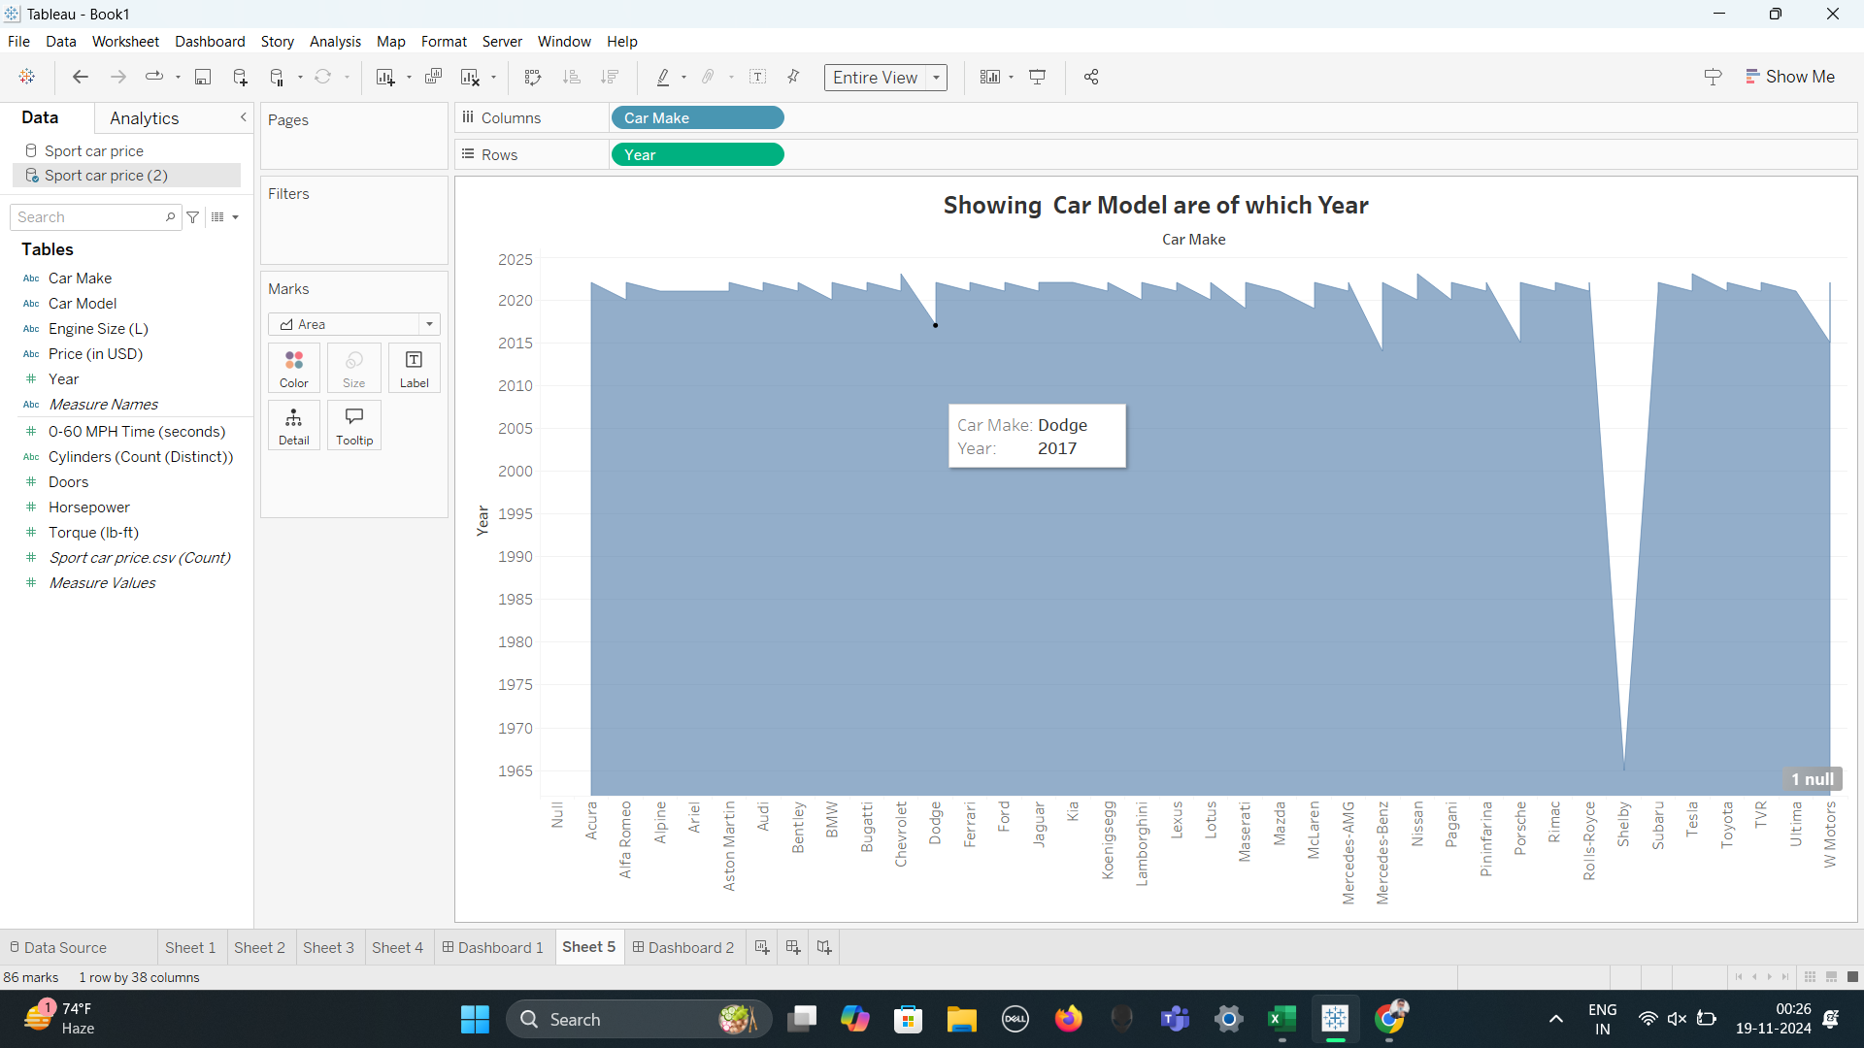
Showing Car Model are of which Year

Slide 14
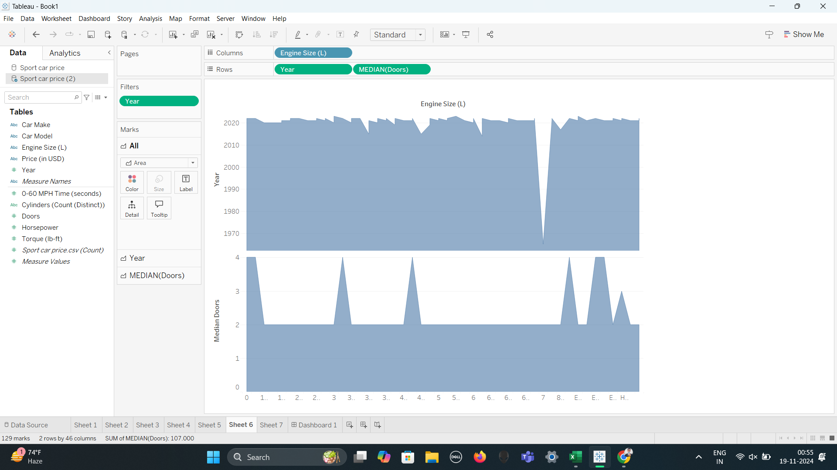
Engine with Production Year and No of doors

